Slide 1
Handling Duplicates in a Dataset

Slide 2
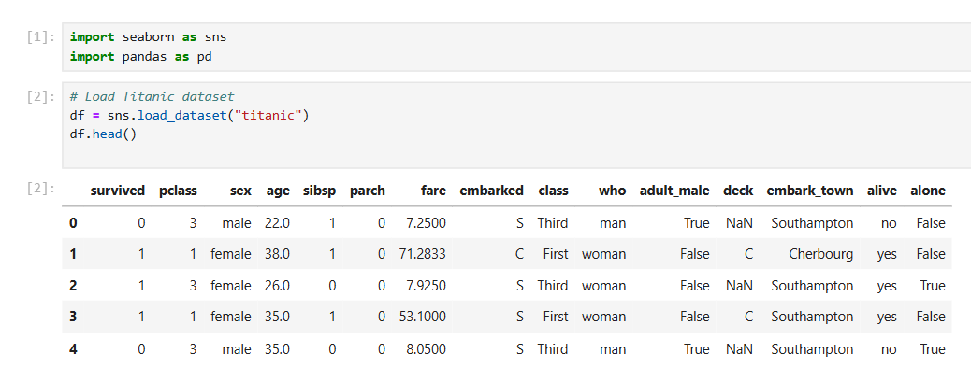
Overview
Duplicates in data can skew analyses and lead to incorrect conclusions.
This presentation uses the Titanic dataset to explain:
What duplicates are.
How to identify them.
Methods to handle duplicates.

Slide 3
What are Duplicates?
Duplicates are rows in a dataset where all or some values
are identical across columns. They are repeated entries or
rows in a dataset that represent the same information.
Common cause:
Data collection errors
Merging datasets
Data entry mistakes.
Why are Duplicates Problematic?
They can skew analysis results.
Lead to inflated counts and incorrect insights.
Waste storage space.

Slide 4
Types of Duplicates
Exact Duplicates :
Rows that are identical across all columns.
2. Partial Duplicates :
Rows identical in some columns but differ in others.
Example: Multiple entries for the same person with
different timestamps.
3. False Positives :
Appear as duplicates but are legitimate records.
Example: Two people with the same name.

Slide 5
Identifying Duplicates

Slide 6
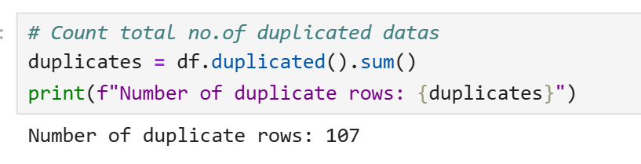
Total no.of Duplicate values
Explanation:
df.duplicated().sum() counts the total number of rows marked as duplicates. This provides a quick overview of the duplication issue in the dataset.

Slide 7
Identifying Duplicates
There are 3 ways to identify the duplicates in a dataset.
1. Identify All Duplicates (Including First Occurrences).
2. Identify Duplicates Based on Specific Columns
3. View Only the Duplicated Rows

Slide 8
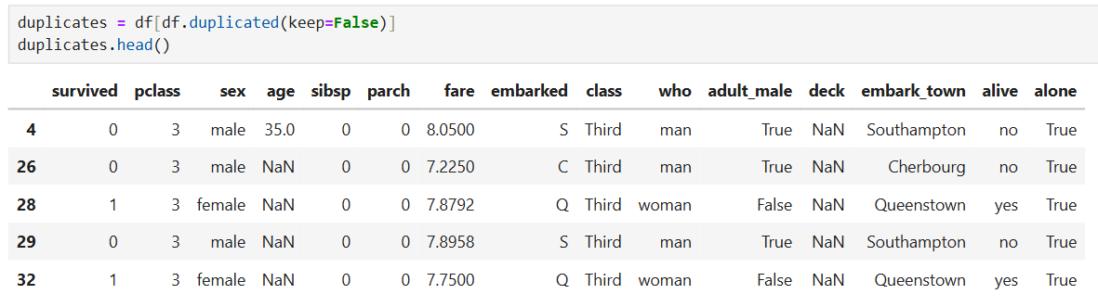
Identify All Duplicates (Including First Occurrences).
Explanation:
df.duplicated(keep=False) returns a Boolean mask where True indicates duplicate rows (including the first occurrence).
df[df.duplicated(keep=False)] filters the dataset to show all rows that are duplicates.

Slide 9
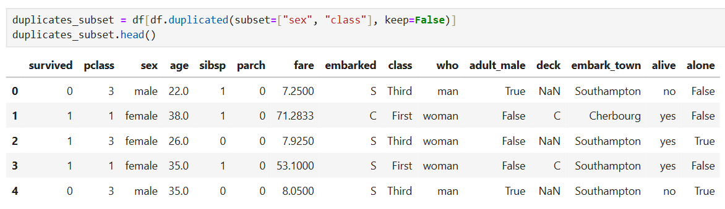
Identify Duplicates Based on Specific Columns
Explanation:
The subset parameter specifies columns to consider when checking for duplicates.
Here, duplicates are identified based on combinations of sex and class.

Slide 10
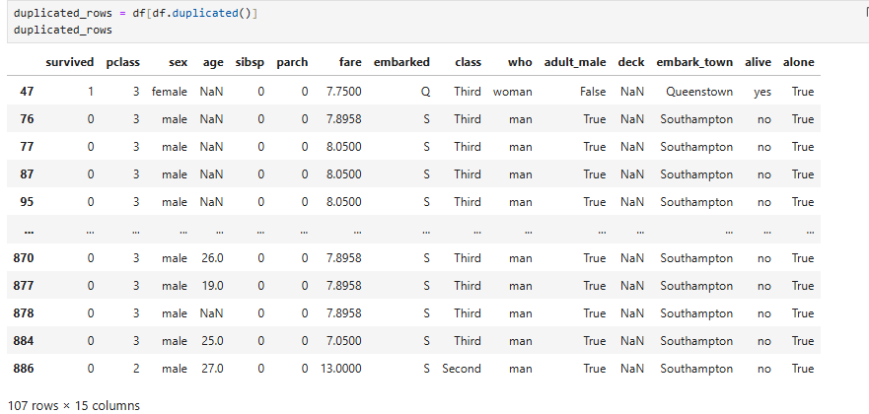
View Only the Duplicated Rows
Explanation:
keep='first' is the default behavior of duplicated(), which marks all duplicates after the first occurrence as True.
This is useful when you only want to see rows considered redundant.

Slide 11
Handling Duplicates

Slide 12
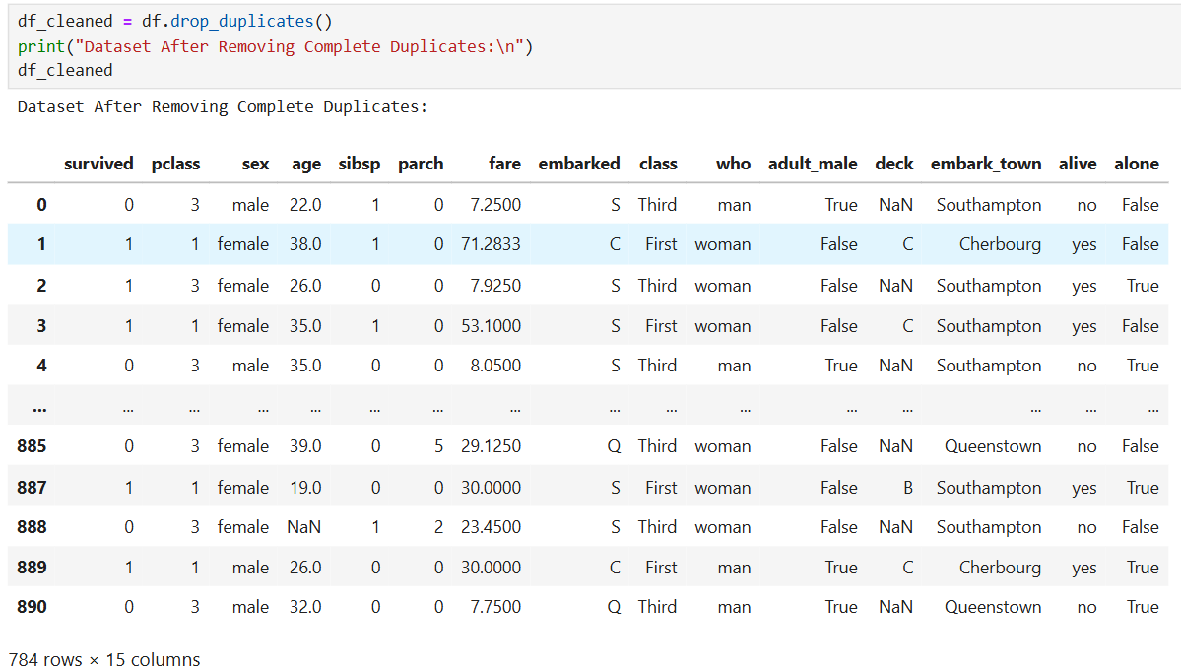
Remove Complete Duplicates
Explanation:
drop_duplicates() removes all duplicate rows, keeping only the first occurrence.
This is useful for cleaning datasets where duplicate rows are unnecessary.

Slide 13
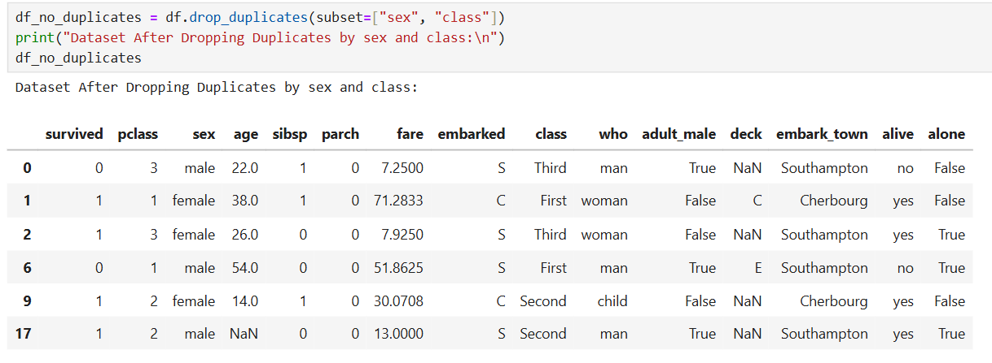
Remove Duplicates Based on Specific Columns
Explanation:
drop_duplicates(subset=["sex", "class"]) removes duplicates based on the specified columns.
Only the first occurrence of each unique combination of sex and class is retained.

Slide 14
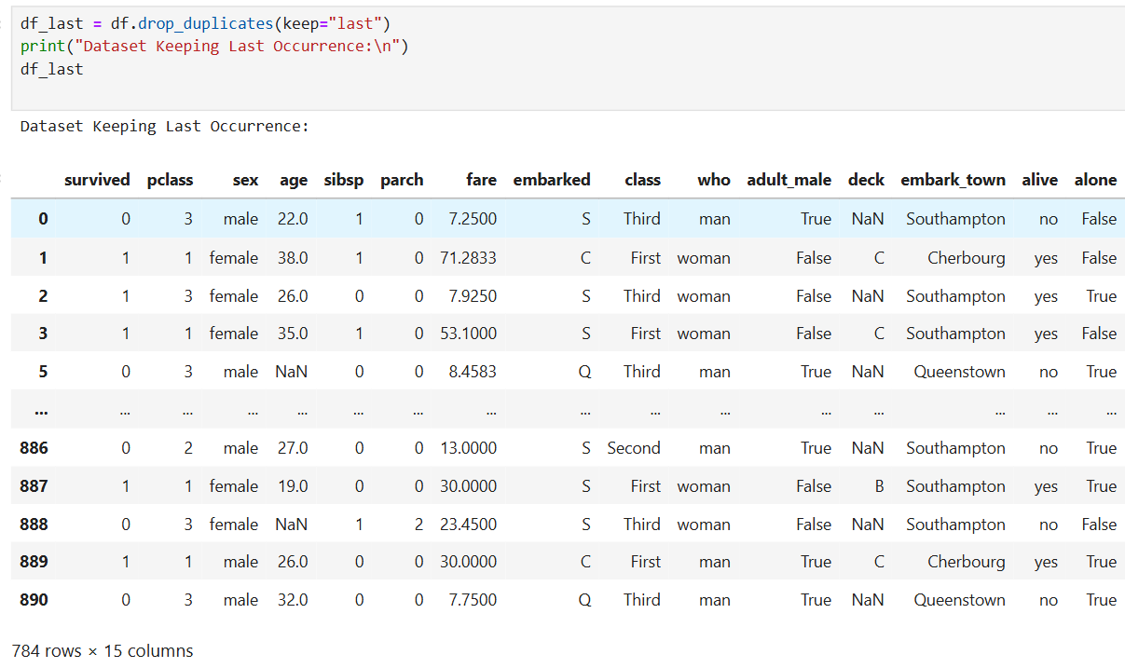
Keep the Last Occurrence of a Duplicate
Explanation:
keep="last" ensures the last occurrence of a duplicate is kept instead of the first.
This is useful when newer data might overwrite older records.

Slide 15
Aggregating Duplicate Data

Slide 16
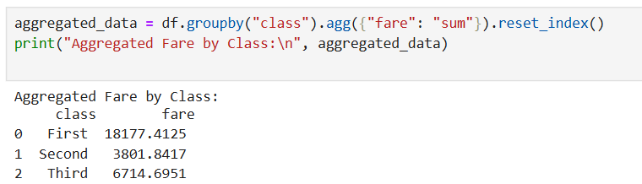
Aggregating Duplicate Data
For rows with partial duplicates, you may want to aggregate data instead of removing duplicates.
Example: Summing fare for Each Passenger Class.
Explanation:
groupby("class") groups the data by class.
.agg({"fare": "sum"}) computes the sum of fares within each group.
reset_index() reverts the grouped data back to a standard DataFrame.

Slide 17
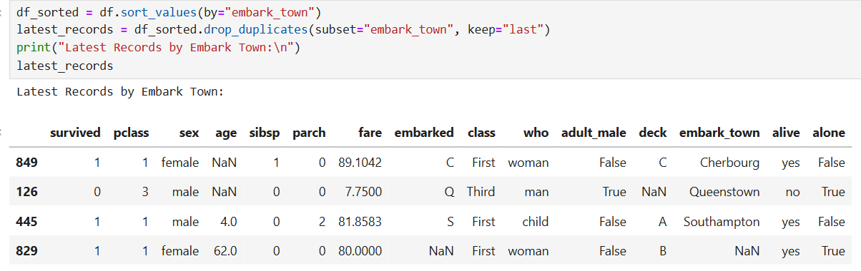
Practical Use Case: Retain the Most Recent Records
For datasets with timestamps (like embarked or class), you can retain the most recent record for each passenger.
Explanation:
sort_values(by="embark_town") sorts the data based on the embark_town column.
drop_duplicates(subset="embark_town", keep="last") ensures only the latest record for each embark_town is retained.

Slide 18
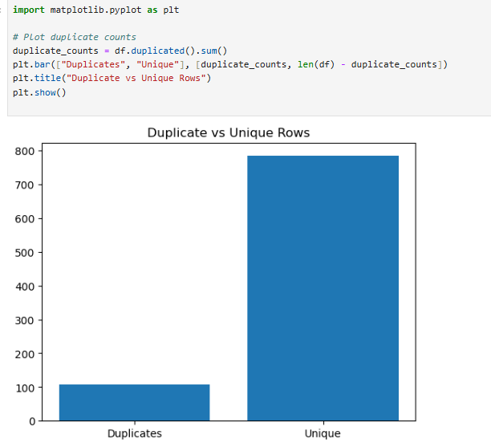
Visualizing Duplicates
Use bar charts or heatmaps to better understand the impact of duplicates.
Explanation:
Counts of duplicate and unique rows are plotted as a bar chart.
This visualization helps stakeholders understand the duplication issue at a glance.

Slide 19
Tips to Avoid Duplicates
Validate Data During Entry:
Use unique IDs for each record.
Automate Checks:
Periodically check for duplicates in your pipelines.
Use pandas to Monitor Uniqueness:
Example: Ensure unique customer IDs.
if not df["CustomerID"].is_unique:
print("Duplicates Found in CustomerID!")

Slide 20
Conclusion
Identifying and handling duplicates is a crucial preprocessing step.
Duplicates can mislead analyses and predictions if not addressed.
Python provides easy-to-use functions in pandas to identify, view, and handle duplicates effectively.

Slide 21
Thank You

